Slide 1
Database Connectivity in PHP

Slide 2
Summary of the previous lecture
Writing regular expression in PHP
Validating user’s input
String functions

Slide 3
Outline
Creating database in MySQL using WAMP
Connecting PHP with MySQL
Inserting data in database
CONNECTIONS: user registration

Slide 4
1. Creating database in MySQL using WAMP
Go to home page of WAMP server
Select PHP myadmin
Login to MySql
Enter database name and click create database button

Slide 5
1. Creating database in MySQL using WAMP…
Creating a table in a database:
Select database from the list of databases
Enter table name and number of columns
Enter name, data-type and other required properties for columns
Click create table button

Slide 6
2. Connecting PHP with MySQL
mysql_connect(“hostname” ,”username”, ”password”)
mysql_connect(“localhost”,”root”,””)
mysql_select_db(“database name”)
mysql_select_db(“testdatabase”)

Slide 7
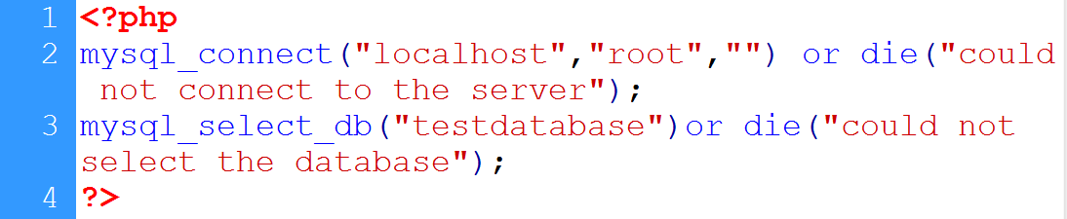
2. Connecting PHP with MySQL…
Connect with server
Empty password
Error message
Host name
username
Select database
Database name

Slide 8
3. Inserting data in database
Create form to receive input from user
On action page
Retrieve user’s input
Validate user’s input (optional)
Establish connection with database
Write insert command
Execute command

Slide 9
3. Inserting data in database…
Insert SQL command:
INSERT INTO `table_name`
(list of columns)
VALUES (list of values)
INSERT INTO users
(‘user_Name’,’user_Email’,’user_Password’)
VALUES (‘$name’,’$email’,’$password’)
mysql_query(query to execute)

Slide 10
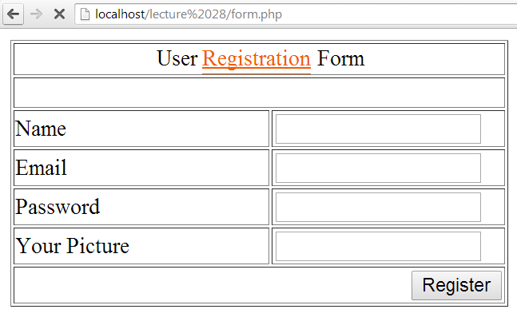
3. Inserting data in database…
post
reg_action.php
for later use
name
email
password

Slide 11
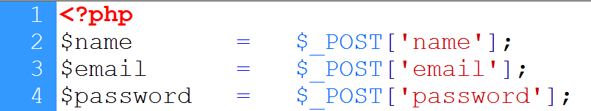
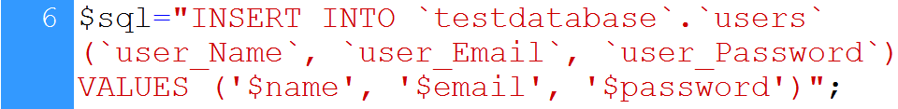

3. Inserting data in database…
User’s input is retrieved
Database connection
Insert command
Command is executed

Slide 12
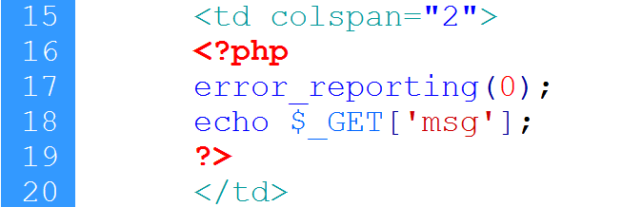
3. Inserting data in database…
Header function
location
message
Close warnings
Message is displayed

Slide 13
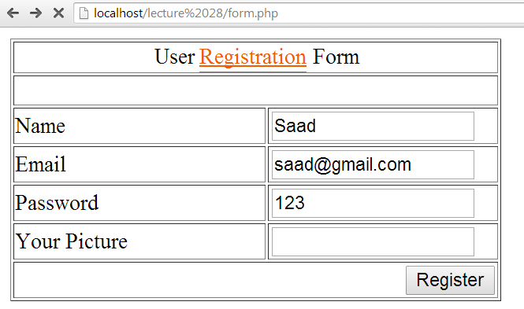
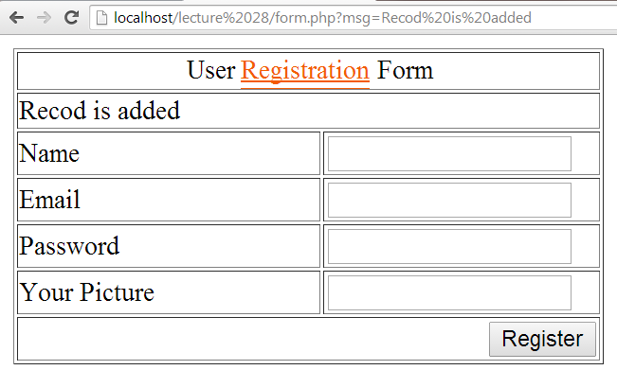
3. Inserting data in database…
message

Slide 14
4. CONNECTIONS: user registration
Create database
Database name: connections
Table name: users
Table columns:
user_Id int 4
User_Name text 25
User_Email varchar 35
User_Password varchar 20
User_Picture varchar 50

Slide 15
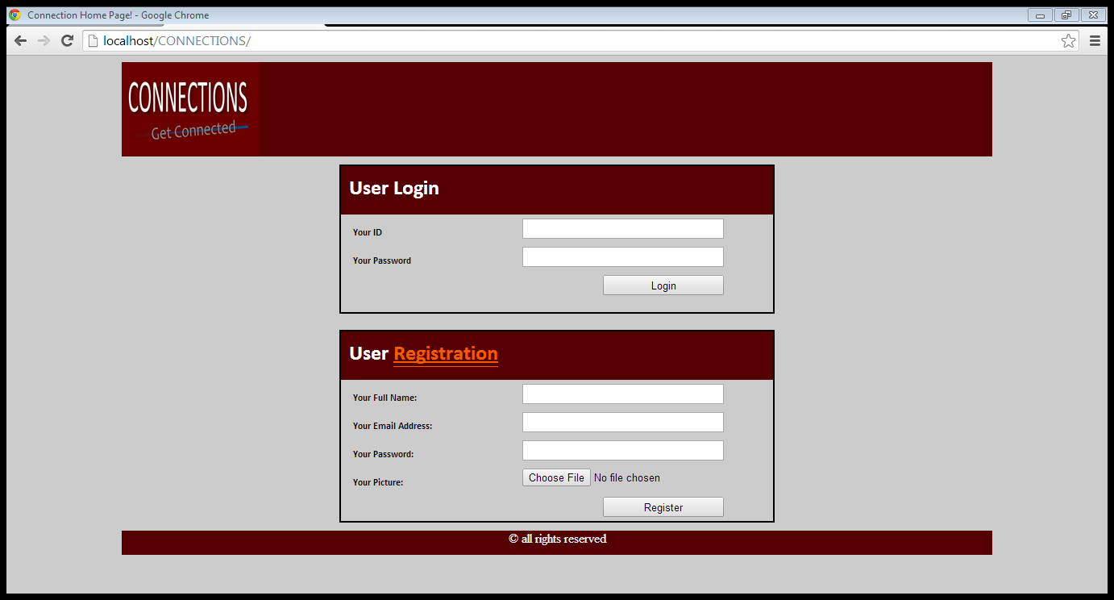
4. CONNECTIONS: user registration…
post
name
email
password

Slide 16
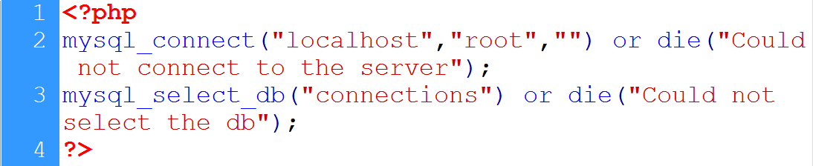
4. CONNECTIONS: user registration…
Connection to the server
Database name
Database selection

Slide 17
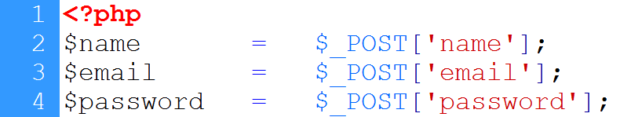
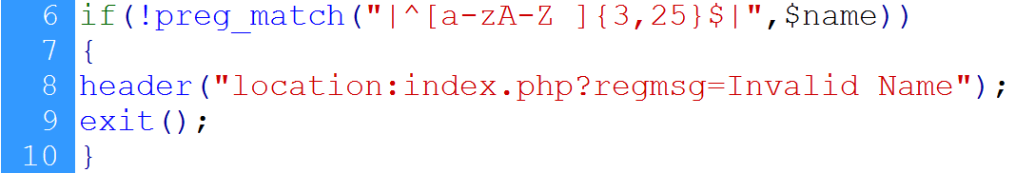
4. CONNECTIONS: user registration…
User’s input is retrieved
Database connection
Name validation

Slide 18
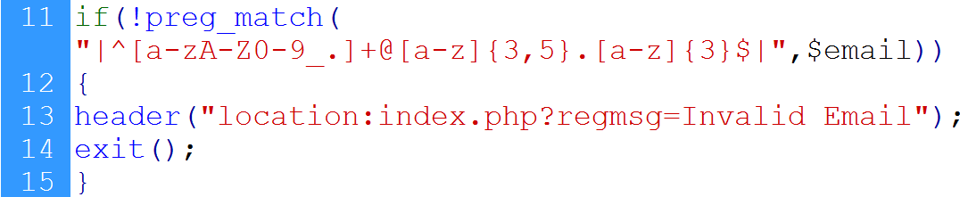
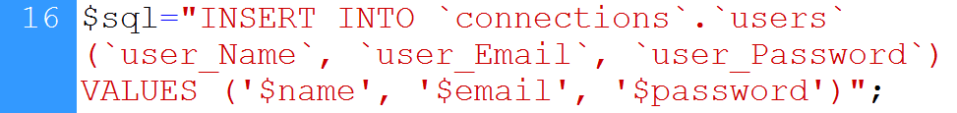
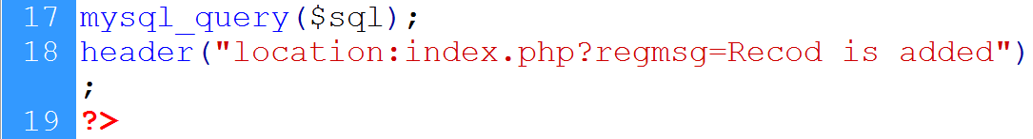
4. CONNECTIONS: user registration…
Email validation
Insert command
Command is executed

Slide 19
Summary
Creating database in MySQL using WAMP
Connecting PHP with MySQL
Inserting data in database
CONNECTIONS: user registration

Slide 20
References
Chapter 30, “Beginning PHP and MySQL” by W. Jason Gilmore, Apress publisher, 4th edition; 2010, ISBN-13 (electronic): 978-1-4302-3115-8.

